Slide 1
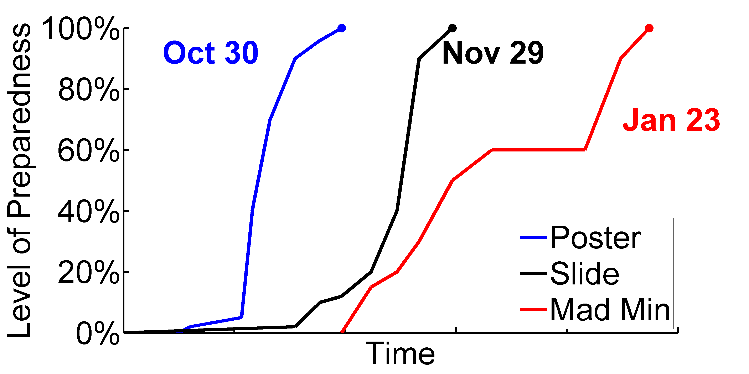
Description | Count | %
Row 1 | 89 | 100
Row 2 | 50 | 56
Row 3 | 47 | 53
Row 4 | 44 | 49
Row 5 | 0 | 0
Row 6 | 19 | 21
$$height(eq)=\frac{min⁡(48pt)}{\lim_{life→0}{(me)}}$$
Contact: youremail.address@utoronto.ca
Place 300+ dpi logos of sponsors, universities, etc (PNG, transparent if possible)

Slide 2
Place 300+ dpi logos of sponsors, universities, etc (PNG, transparent if possible)

